Slide 1

Project Title: Leader-Based Community Detection Algorithm in Attributed Networks
Team Number:DB4
ROLL NO. | NAME
AM.EN.U4CSE20339 | Krishnpriya Dinesan
AM.EN.U4CSE20366 | Sreesankar S
AM.EN.U4CSE20321 | Devesh Kumar V V
AM.EN.U4CSE20152 | Pranav B Nair
Amrita School of Computing | Amrita Vishwa Vidyapeetham | Amritapuri

Slide 2
Introduction
Focus: Identify leaders and organize communities within an attributed dataset.
Goal: Utilize data analysis and community detection algorithms to reveal leadership dynamics and community structures.
Solution: Apply data analysis techniques and community detection algorithms, such as modularity or Louvain, for insightful visualization of the dataset.
Benefits: Enhance decision-making, optimize resource allocation, and foster efficient collaboration by gaining insights into leadership dynamics and facilitating cross-community interactions.

Slide 3



Motivation
Real life motivation scenario:
Social Media Analysis:
Influencer Identification
Content Recommendation
Epidemiology and Disease Spread:
Identifying Super-Spreaders
Vaccination Campaigns
Marketing and Customer Segmentation:
Customer Segmentation
Identifying Brand Advocates

Slide 4
Background Study/Related Work
Title &year | Problem | Contributions | Limitations | Open problems/Future work
Leader-aware Community Detection in Complex Networks Springer [2019] | Study the problem of community detection in complex networks and propose a novel method, which can detect community structures automatically as well as identify community leaders. | Leader-aware community detection algorithm that incorporates the concept of leadership to improve the accuracy of community detection. | Assumes a static network, where the connections between nodes remain constant throughout the analysis. The algorithm may not perform optimally on very large networks | Investigating the algorithm’s performance on dynamic networks, exploring the impact of different leadership score definitions, and enhancing the algorithm’s scalability for large-scale networks.
Leader Similarity Based Community Detection Approach for Social Networks IEEE [2020] | Addresses the challenge of simultaneous community detection and leader selection in social networks without prior knowledge of community sizes and numbers. | Proposes the "Leader Similarity Based Community Detection (LSBCD)" algorithm | Algorithm's focus is on non-overlapping communities Another limitation is on the applicability to extremely large and dynamic networks(real-time social media platforms) | Extending LSBCD for overlapping communities in social networks to enhance real-world applicability. Testing on dynamic social media platforms to assess its performance. Scalability for big data scenarios.

Slide 5
Title &year | Problem | Contributions | Limitations | Open problems/Future work
Leader-Based Community Detection Algorithm in Attributed Networks IEEE [2021] | Need for an improved community detection method that incorporates both topological and attribute information to maintain the integrity of information in complex networks. | Introduces TALB, a leader-based method that integrates topological and attribute information. A dependency tree is formed by combining attribute similarity matrices with network topology. | Faces efficiency challenges in large, dense networks. Incorporating topological and attribute information may increase computational overhead. Addressing this requires efficient algorithms and extensive evaluations for real-world applicability. | Parallelization, distributed computing, or sampling approaches to improve scalability. Also investigate the robustness of the TALB method under different perturbations, such as node removal, edge addition, or changes in attribute data.
Community Detection in Attributed Networks Using Graph Wavelets. IEEE [2022] | Graph signal processing-based approach to community detection in attributed networks. | Spectral graph wavelets to filter the attributes and constructs a new network from the graph filtered attributes across different scales. | Computational complexity, sensitivity to graph structure, and challenges with continuous attributes and attribute dependencies. | Other kernel functions and the extension of this framework to detect multi-scale community structure.

Slide 6
Persisting Challenges
Challenges Identified
Effective leader selection in the network.
Visualization of the large Dataset is Difficult.
Scalability and efficiency, particularly in large-scale networks.
Incorporating topological information into the algorithm.

Slide 7
Project Contributions
The project contributes in the following ways:
Improved Leader Detection: Leader detection through attributes helps to capture a combined measure of leadership potential, considering multiple attributes.
Improved Community Detection: The primary objective is to develop an algorithm that bridges the gap between topological and attribute information for more accurate community detection.
Enhancements: Addressing the challenge of scalability in large-scale networks to ensure the algorithm's applicability to real-world scenarios.
What are the objectives?
The objectives of the project include developing and implementing the Leader-Based Community Detection Algorithm, optimizing leader selection, and evaluating the algorithm's performance in real-world attributed networks.

Slide 8
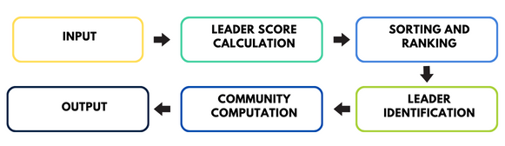
High Level Design

Slide 9
Algorithms/Methodology
Two algorithms implemented:
Leader Selection Algorithm: This algorithm will focus on identifying influential leaders within the network, considering both topological characteristics and attribute information. It should effectively select nodes that can guide the community detection process.
Community Detection Algorithm: This algorithm will form the core of the project, aiming to detect communities by combining attribute similarity matrices with network topology. It should efficiently identify cohesive and meaningful communities within the attributed network.

Slide 10
Algorithms/Methodology
LEADER SELECTION ALGORITHM
Here we will be using the eigen vector centrality and the attribute information to compute a Composite/Leadership score which will be later considered to sort and rank the total list to get the top leader's list.
Eigen Vector Centrality: It is a measure of the influence or importance of a node in a network, based on the concept that connections to high-scoring nodes contribute more to a node's centrality.
COMMUNITY COMPUTATION:
Louvain Method: This method optimizes a modularity score to find communities in a network. It can be extended to attributed graphs by considering node attributes in the modularity calculation.
Greedy Modularity: The key idea behind this algorithm is to iteratively add nodes to communities in a way that maximizes the modularity of the resulting partition.

Slide 11
Algorithms/Methodology
Advantages of Louvain Method/ Greedy Modularity Communities over other Algorithms:
Modularity Optimization: Maximizes modularity score for strong community division.
Attribute Consideration: Extends to attributed networks, incorporating node attributes in modularity optimization.
Community Quality: Focuses on high-quality communities with similar nodes.
Scalability: Efficient for large networks.
Adaptability: Suited for dynamic networks, capturing evolving community structures.
Widespread Adoption: Popular choice across various fields for effective community detection.
Flexibility and Adaptability: Flexible and can be applied to a variety of network types, including social networks, biological networks, citation networks, and more.

Slide 12
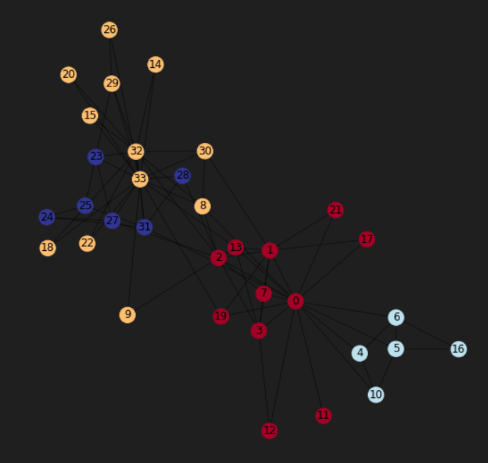
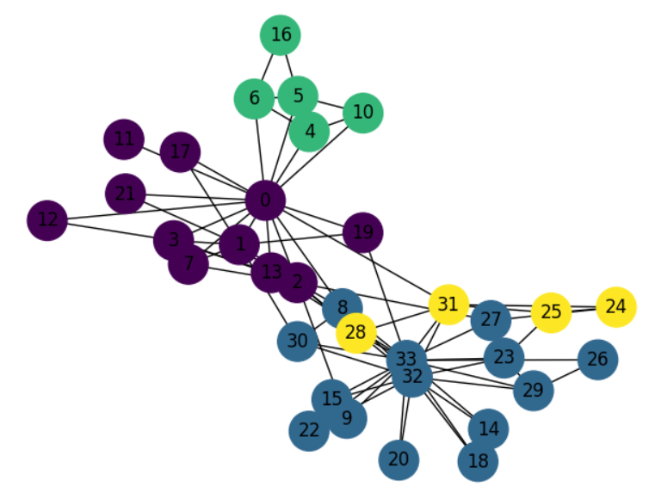
Progress After First Review:
Worked on an Unattributed Dataset called Zachary's Karate Club.
Implemented community detection algorithms using Girvan Newman and Louvain algorithms.
Implemented the same community detection algorithm by finding a leader and found that the communities we got were different.
Graph with the leaders identified

Slide 13
Experimental Setup
Here we have experimented on two different datasets:
FACEBOOK DATASET
CORA DATASET

Slide 14
DATASET-1(FACEBOOK DATASET)
This dataset consists of friends lists from Facebook. Facebook data was collected from survey participants using this Facebook app. The dataset includes nodes as profiles and edges as their connection
Description
Nodes:
Each node in the dataset represents a Facebook profile or user account.
Nodes could include individuals who participated in the survey or whose data was collected through a Facebook app.
Edges:
Edges between nodes represent connections or friendships between individuals on Facebook.
If there is an edge between nodes A and B, it indicates that the user associated with node A is friends with the user associated with node B.
Dataset statistics
Nodes | 4039
Edges | 88234

Slide 15
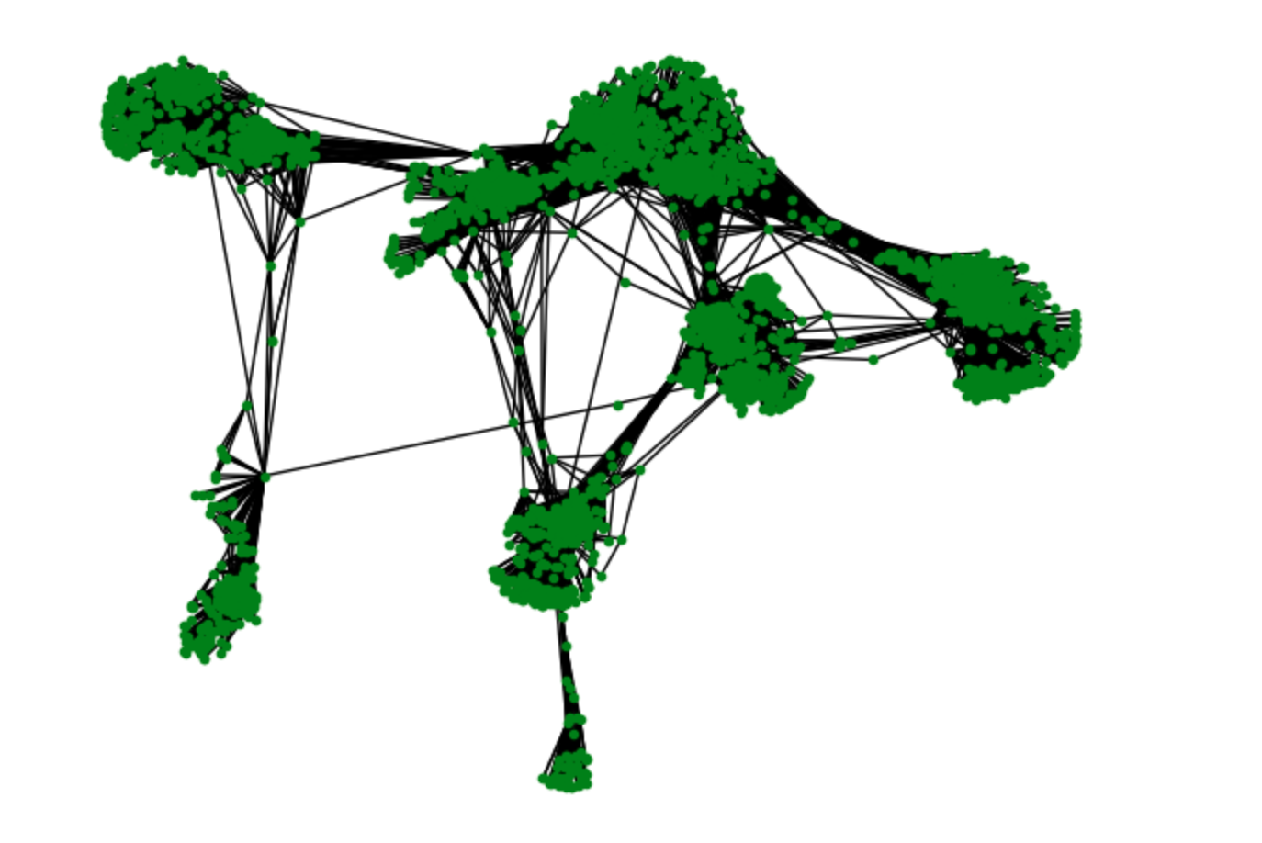
Experimental Setup
Visualization of the Dataset

Slide 16
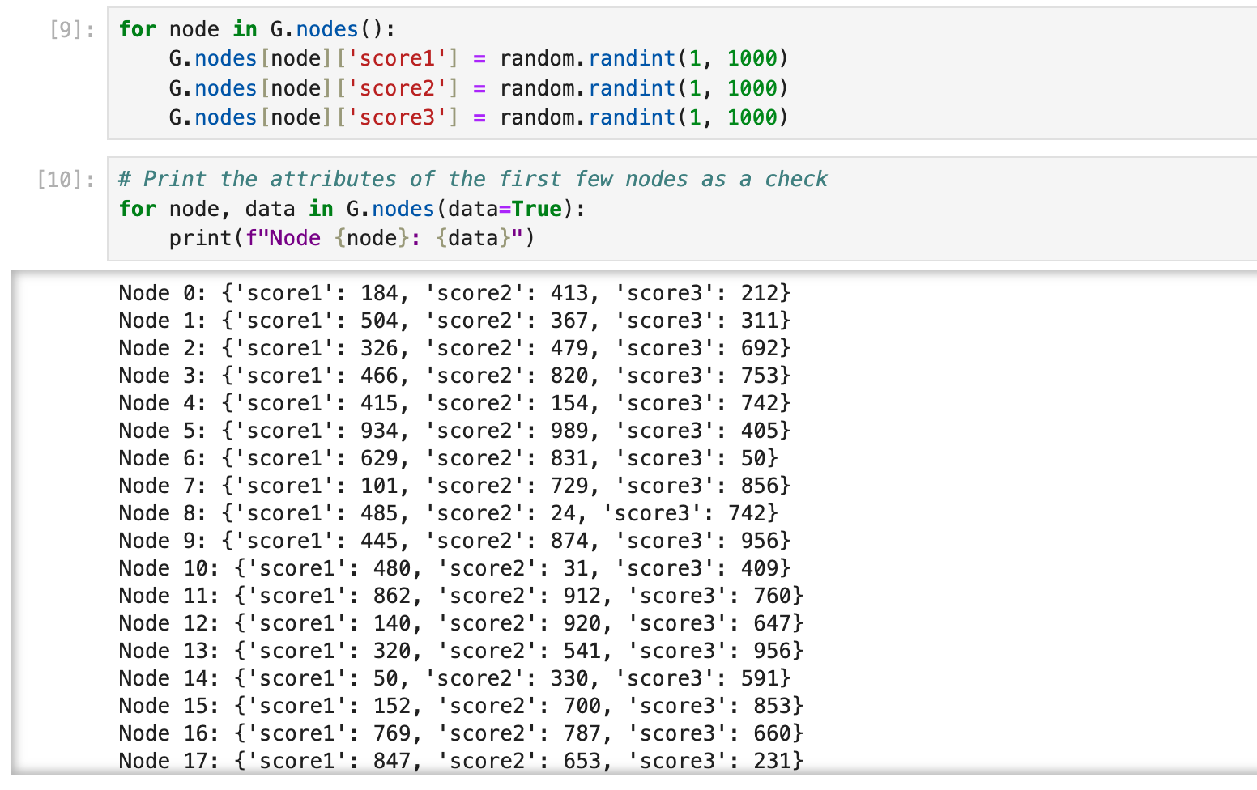
Experimental Setup
Here we are adding attributes to all the nodes, where the attributes does not have a real-life application

Slide 17
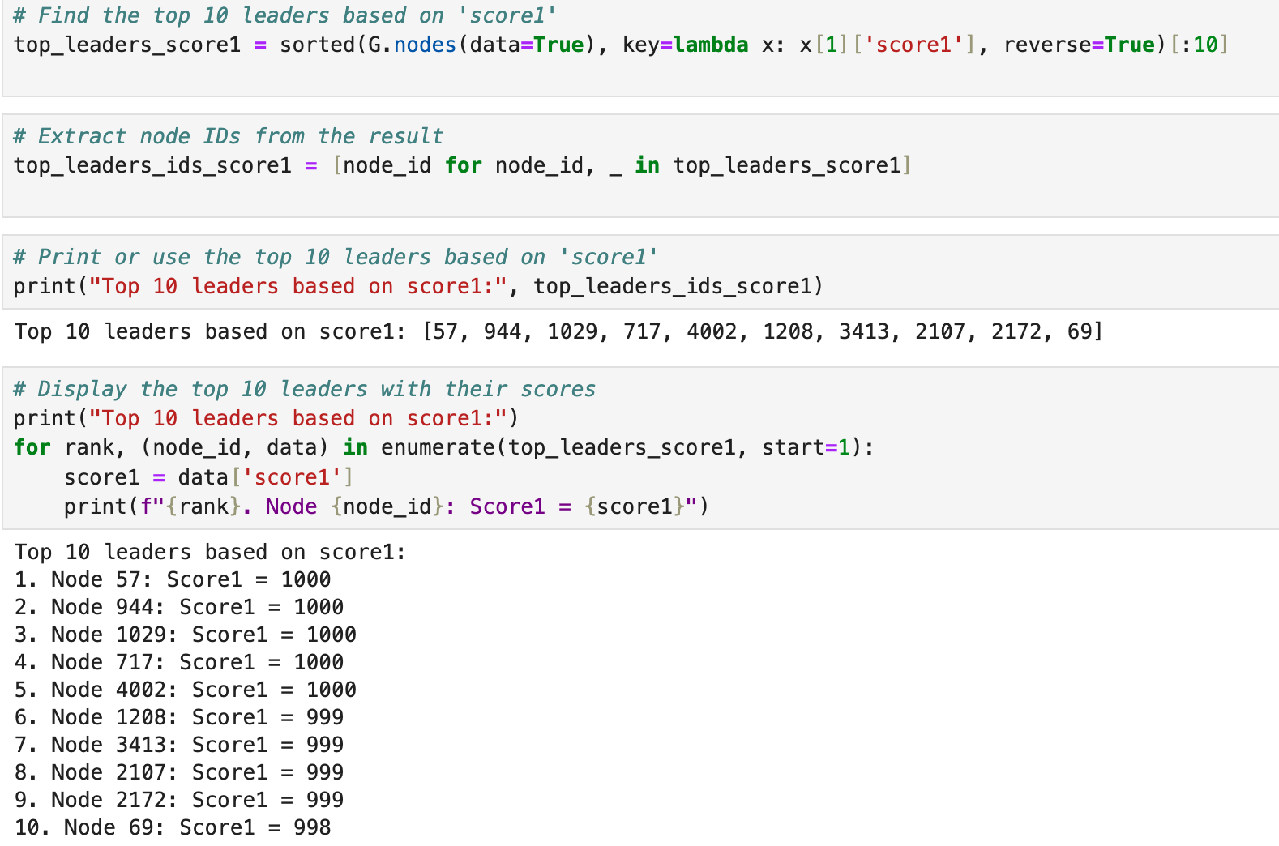
Experiments and Results
Leader detection based on attributes
We can detect leaders based on a particular attribute
This can be very helpful in real world application

Slide 18
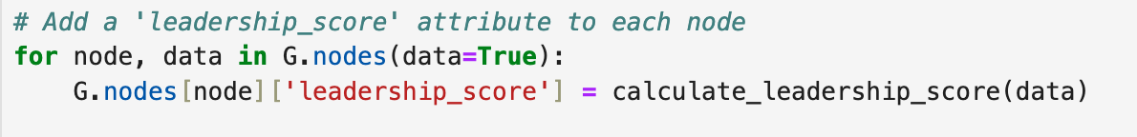
Experiments and Results
Now we are assigning a leadership score based on the three attributes.
According to this score , we will decide our leader

Slide 19
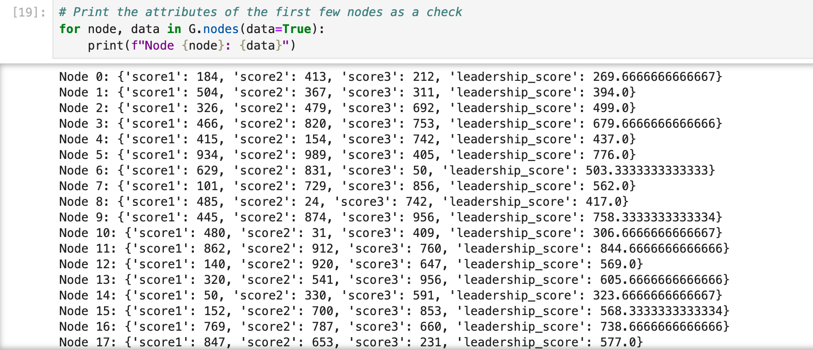
Experiments and Results
All nodes with leadership scores

Slide 20
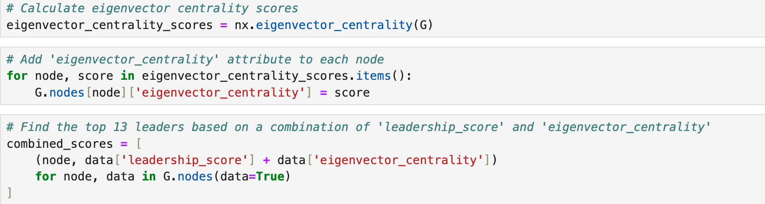
Experiments and Results
Now we may arise with a question were, what if the leadership scores of two or more nodes are the same?
In that case we also compute the eigen vector centrality and give a priority for it

Slide 21
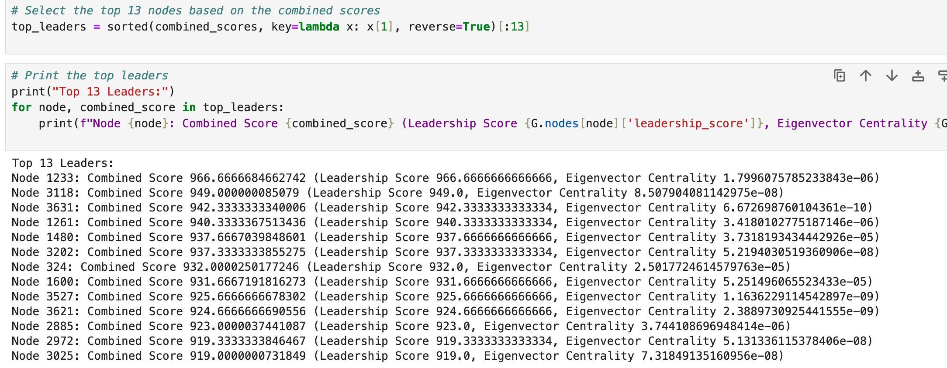
Experiments and Results
Removing that issue we are printing top 13 Leaders

Slide 22
Experiments and Results​
Greedy Modularity Calculation:
Initialization:
Start with each node as a separate community.
Calculate the initial modularity of this partition.
Iteration:
For each node, consider moving it to its neighbors' communities one at a time.
If moving the node to a neighbor's community increases the overall modularity, make the move.
Repeat this process for all nodes in the network.
Termination:
Repeat the iteration until there is no further improvement in modularity or until a specified condition is met.
Output:
The final output is the partition of nodes into communities that maximizes the modularity.
Here the Leader node is considered as the starting node

Slide 23
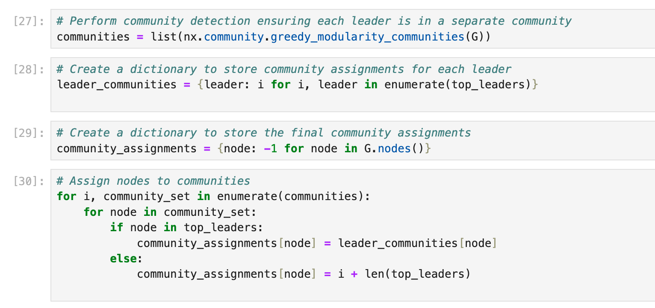
Experiments and Results
Community detection based on Leaders

Slide 24
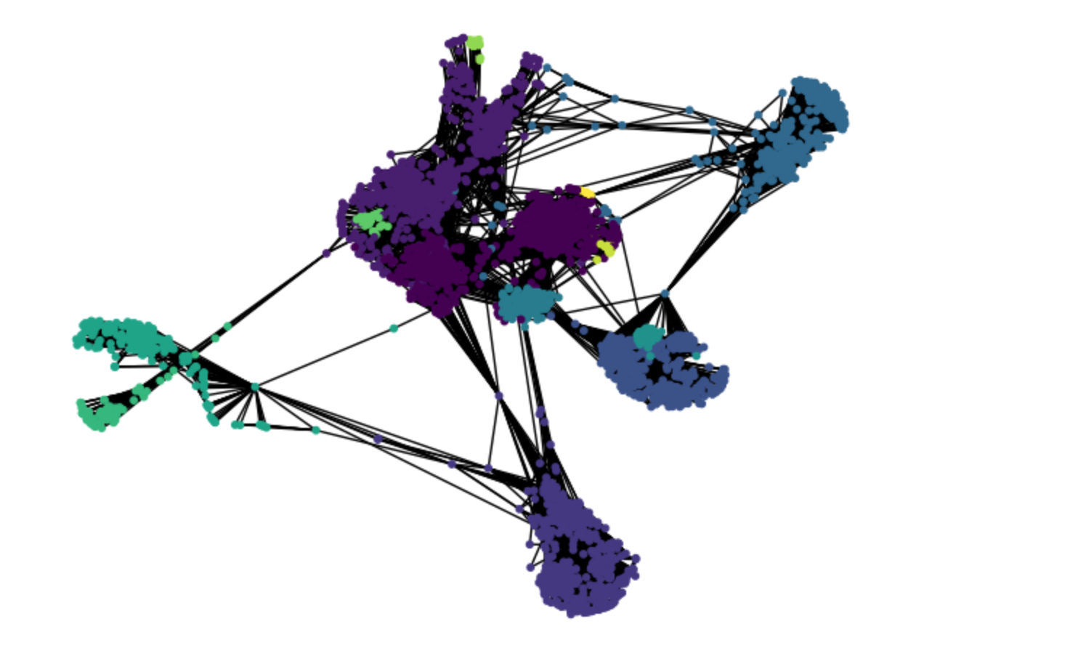
Experiments and Results
Visualization of communities in Jupyter notebook

Slide 25
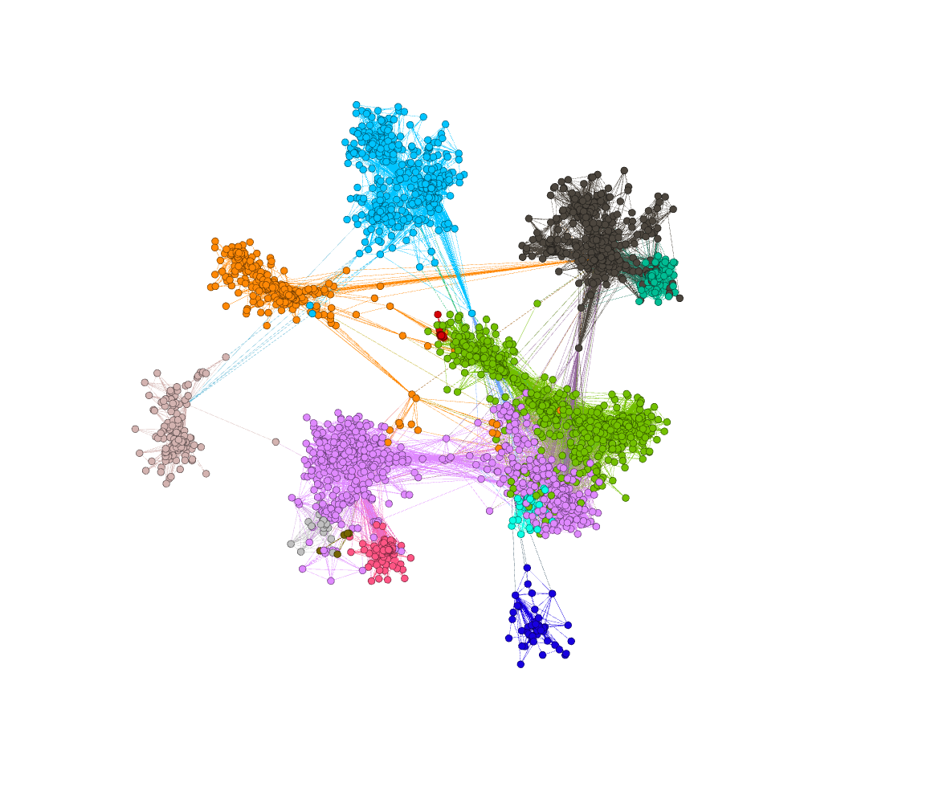
Experiments and Results
Final Visualization of communities done on Gephi

Slide 26

Experiments and Results
3D Visualization of communities done on Gephi

Slide 27
DATASET-2(CORA DATASET)
The Cora dataset is a citation network dataset representing scientific publications, where nodes correspond to documents and edges represent citations between documents.
The Cora dataset comprises 2708 machine learning papers classified into seven categories. Each paper is represented in the .content file with a unique ID, binary values indicating the presence of words from a 1433-word vocabulary, and a class label. The .cites file details the citation graph, specifying links between papers with the direction from citing paper to cited paper. The papers were selected to ensure mutual citations, resulting in a vocabulary after preprocessing, including stemming and stopword removal, with 1433 words, and words with a document frequency below 10 were removed.
Dataset statistics
Nodes | 2708
Edges | 5429

Slide 28
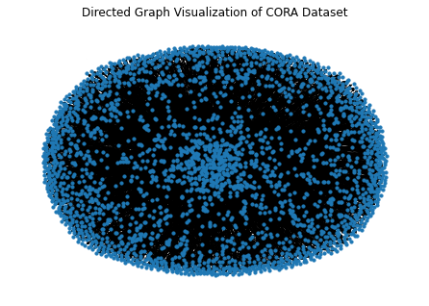
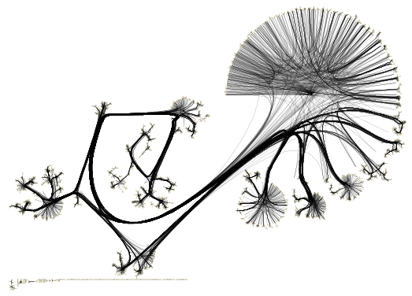
VISUALIZATION
A visualization from yED

Slide 29
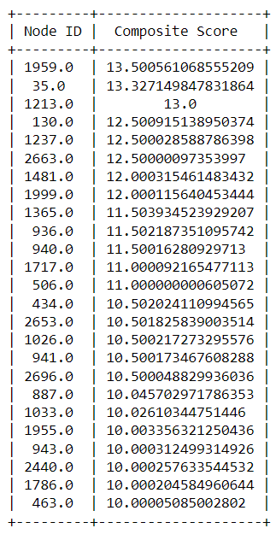
LEADER IDENTIFICATION ALGO
Load the Cora dataset:
Read the .content file to obtain the attributes for each paper.
Read the .cites file to obtain the citation graph.
2. Preprocess the data:
Extracted the word attributes and class labels from the .content file.
3. Construct the graph:
Build a graph using NetworkX, where nodes represent papers and edges represent citations.
4. Compute eigenvector centrality:
Calculated eigenvector centrality for each paper in the graph.
5. Create a composite score:
Combined eigenvector centrality with other attributes to create a composite score.
6. Identify top leaders:
Sorted the papers based on the composite score and selected the top leaders.

Slide 30
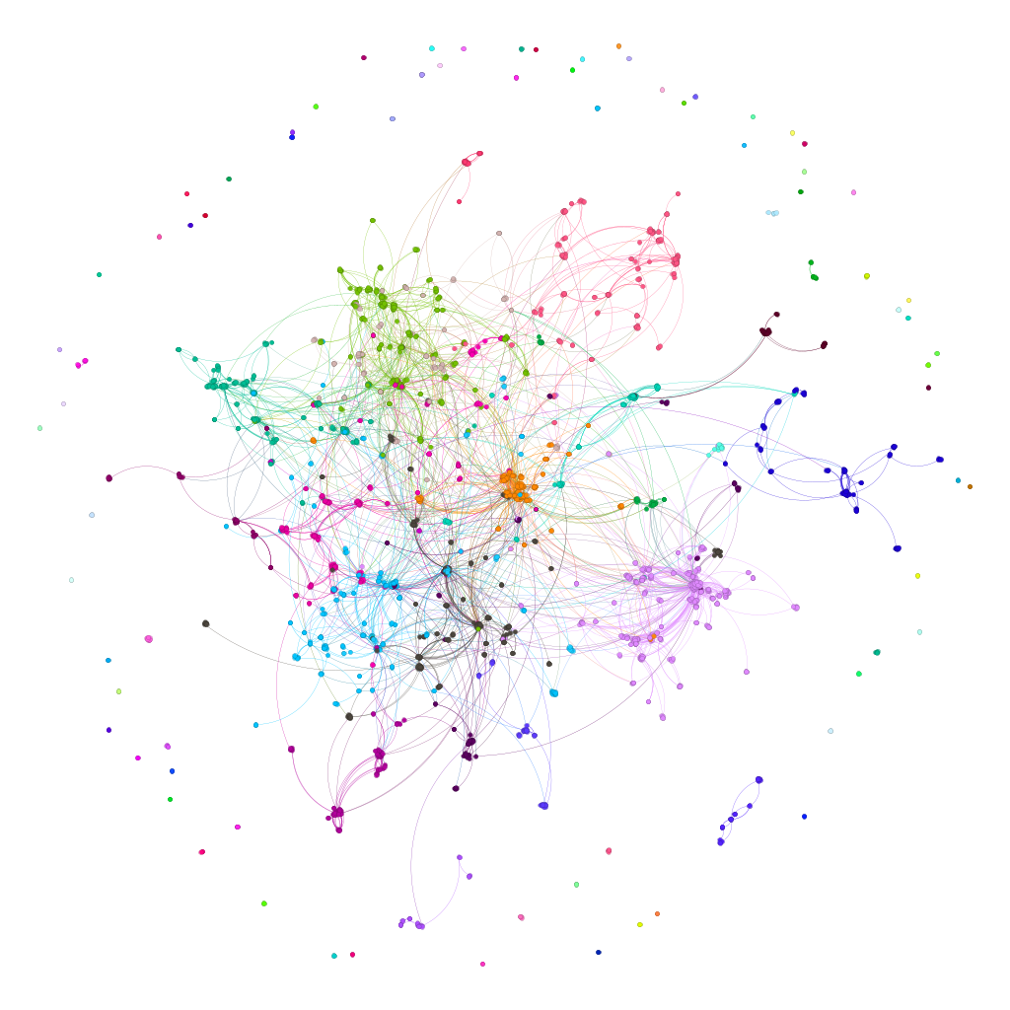
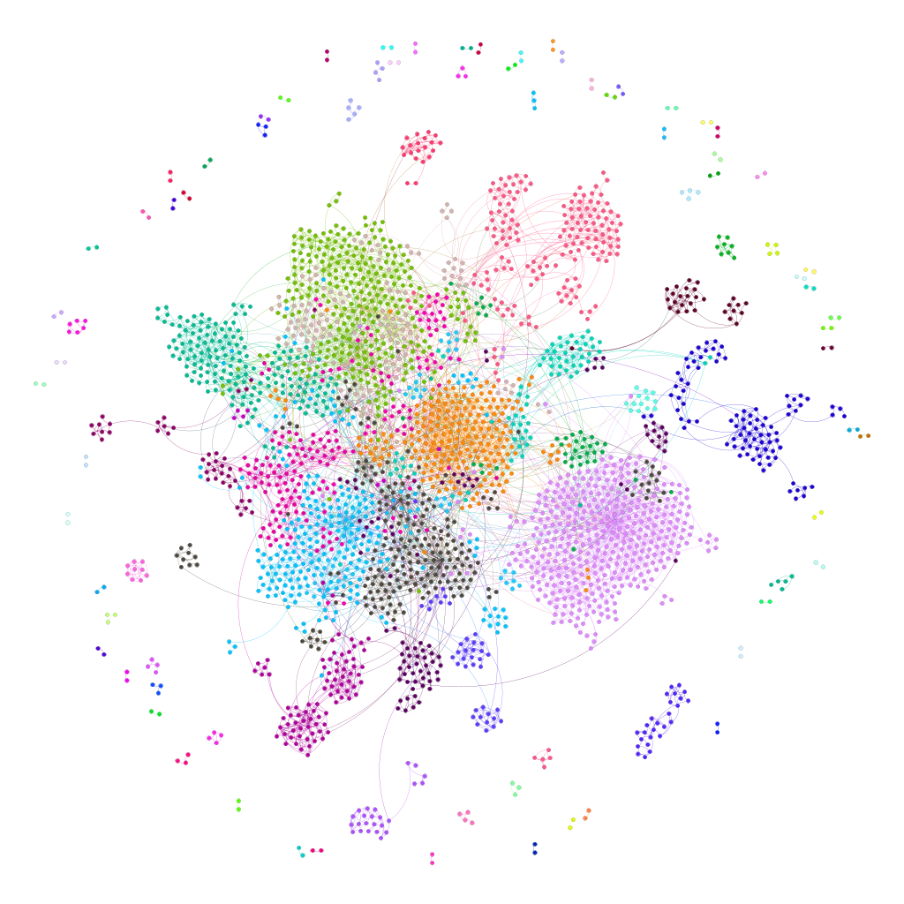
COMMUNITY DETECTION ALGO
Convert the Directed Graph to Undirected
Compute the best partition using the Louvain algorithm for the subgraph induced by top leaders
Assign community labels to nodes in the original graph
Create a Mapping of Community IDs to Colors and Get Node Colors Based on Assigned Community.
Export the Graph to a GraphML File.
Visualizations in gephi

Slide 31
Results
Implementation of the Eigenvector Centrality-based Leader Selection Algorithm effectively identified influential leaders.
Eigenvector Centrality demonstrates robustness in leader identification, considering both topological characteristics and attribute information.
The Louvain method efficiently optimized modularity, especially for large networks.
Integration of attribute information enhanced the algorithm's ability to identify cohesive and meaningful communities.

Slide 32
Conclusion
The project stands out through its integration of topological and attribute information for enhanced community detection, addressing a critical gap in existing methodologies.
The developed algorithm significantly enhances community detection accuracy, offering practical benefits in various domains such as social media analysis, epidemiology, and marketing.
Current Limitations in the Work:
The incorporation of topological and attribute information may increase computational overhead.
Future Scope:
Addressing scalability challenges through parallelization, distributed computing, or sampling approaches.
Examining the algorithm's resilience to various disturbances to determine its practicality.
Making it suitable for dynamic networks.

Slide 33
References
[1] A. Kesarwani, A. Singh, K. Gaurav and A. K. Shankhwar, "Leader Similarity Based Community Detection Approach for Social Networks," 2020 IEEE International Conference for Innovation in Technology (INOCON), Bangluru, India, 2020, pp. 1-6, doi: 10.1109/INOCO
[2] D. -D. Lu, "Leader-Based Community Detection Algorithm in Attributed Networks," in IEEE Access, vol. 9, pp. 119666-119674, 2021, doi: 10.1109/ACCESS.2021.3109124.
[3] Sun, Heli & Du, Hongxia & Huang, Jianbin & Li, Yang & Sun, Zhongbin & He, Liang & Jia, Xiaolin & Zhao, Zhongmeng. (2020). Leader-aware community detection in complex networks. Knowledge and Information Systems. 62. 10.1007/s10115-019-01362-1.
[4] Ahajjam, Sara & Mohamed, El Haddad & Hassan, Badir. (2018). A new scalable leader-community detection approach for community detection in social networks. Social Networks. 54. 41-49. 10.1016/j.socnet.2017.11.004.
[5] Yakoubi, Zied & Kanawati, Rushed. (2014). LICOD: A Leader-driven algorithm for community detection in complex networks. Vietnam Journal of Computer Science. 1. 241-256. 10.1007/s40595-014-0025-6.
[6] Shah, Devavrat & Zaman, Tauhid. (2010). Community Detection in Networks: The Leader-Follower Algorithm.

Slide 34
Thank You!

